Slide 1
Chapter 1
Database Systems

Slide 2
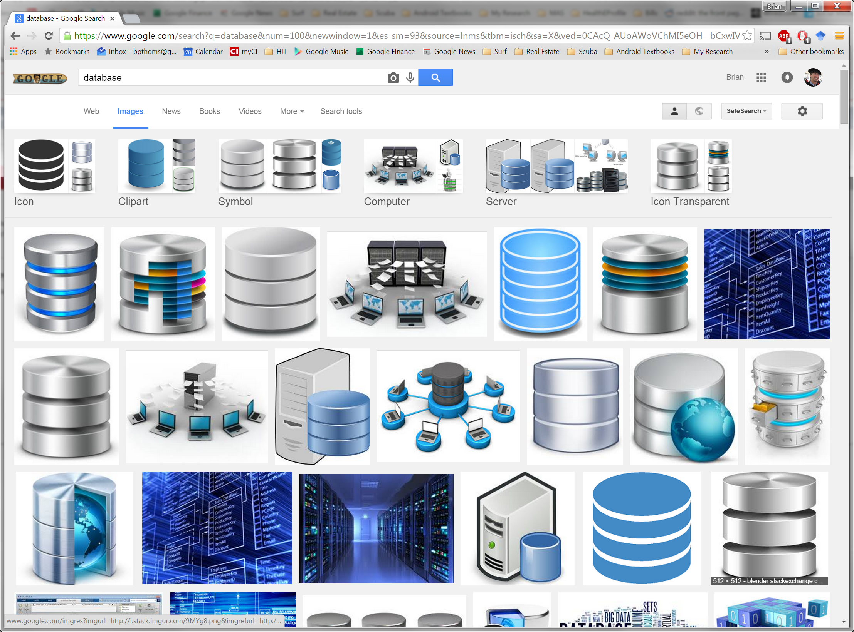

This is a database
Any Questions?

Slide 3
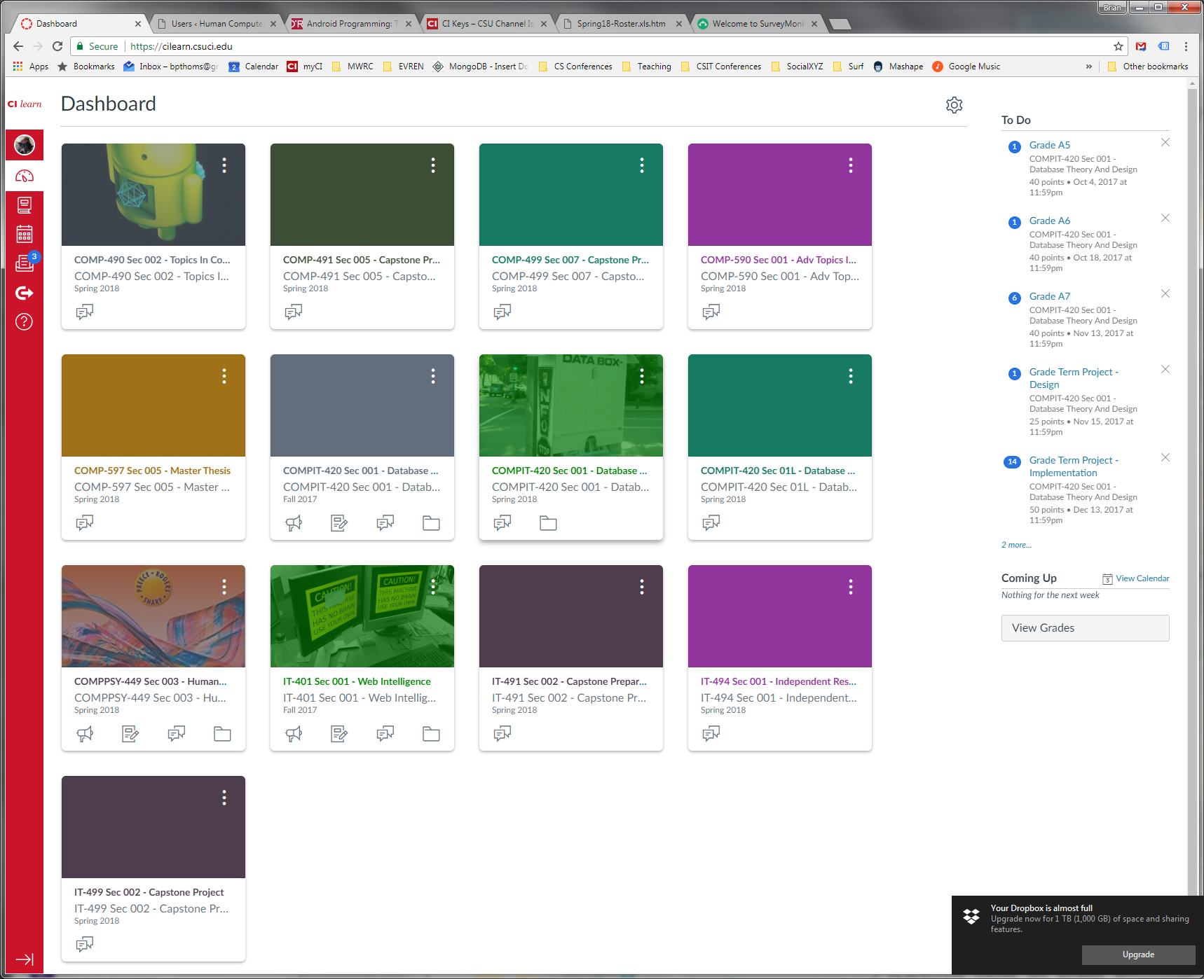
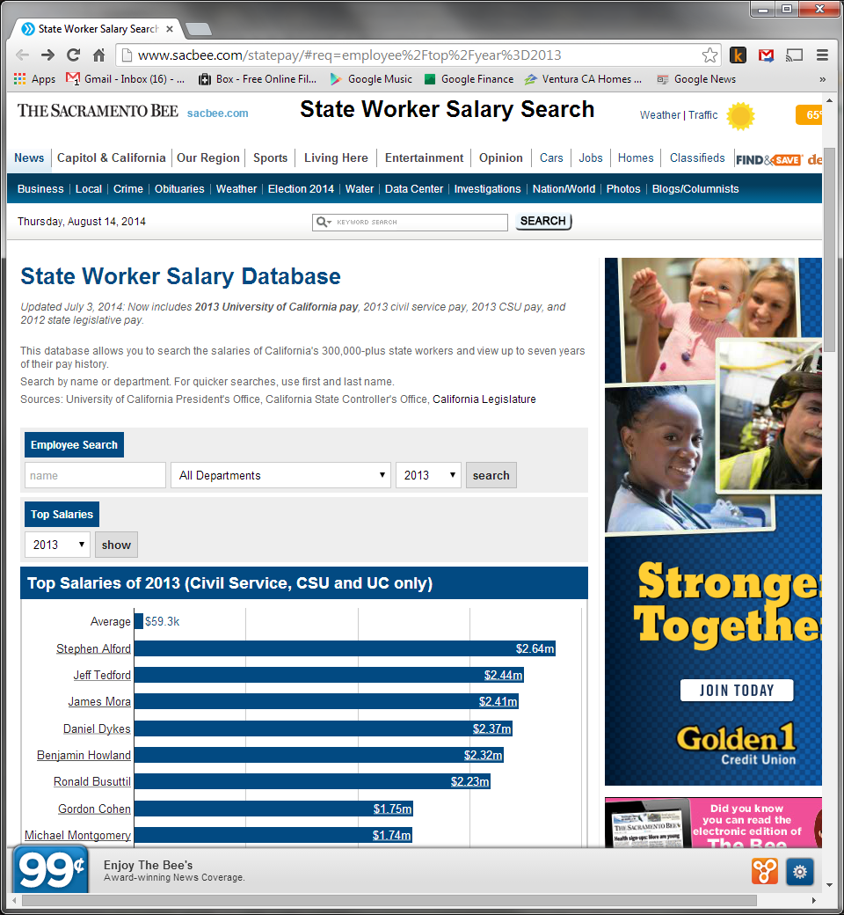
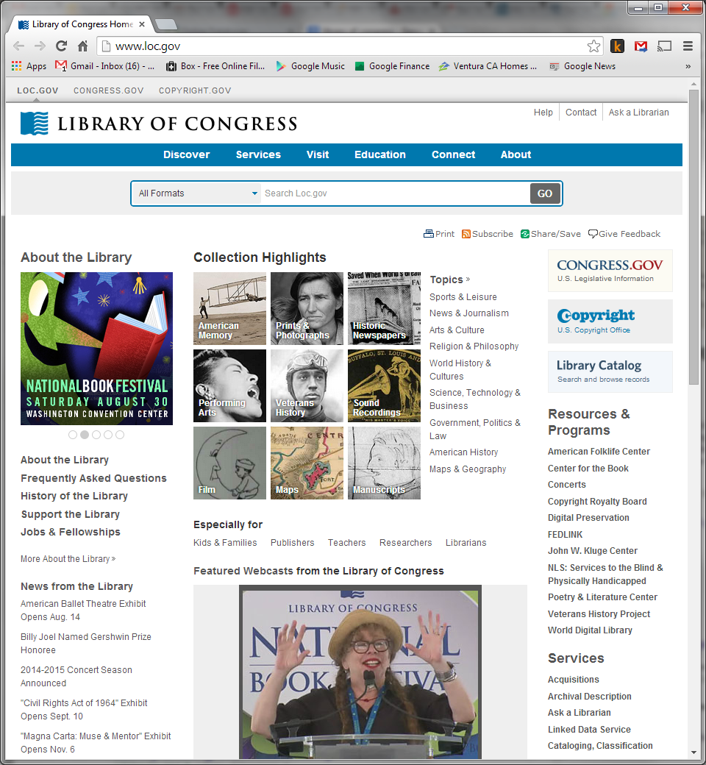

Examples of Databases

Slide 4
Chapter 1 Objectives
This chapter covers:
The difference between data and information
What a database is and why they are valuable assets for decision making
The importance of database design
How modern databases evolved from file systems
Flaws in file system data management
The main components of the database system
The main functions of a DBMS

Slide 5
DB Introduction (1)
Data are raw pieces of information
Information is data organized to convey meaning (derived from raw facts)
Good Decisions require Good Information (GIGO?)
Databases help manage data efficiently for…
?
?
And…
Timing can mean everything.

Slide 6

DB Introduction (2)
Evolved from computer file systems (think text files or spreadsheets (aka MS Excel) )
Understanding file system characteristics plays an important role in understanding the importance of a DBMS.
NoSQL is moving back towards file-based systems.

Slide 7
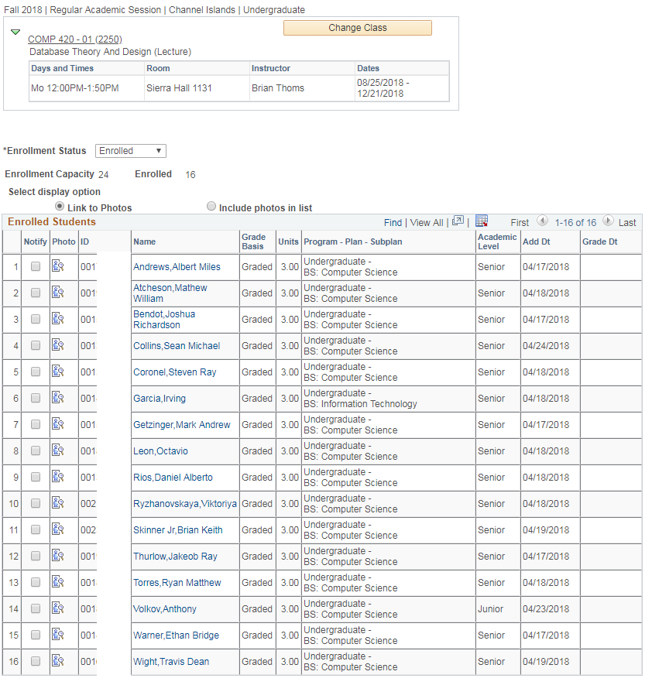
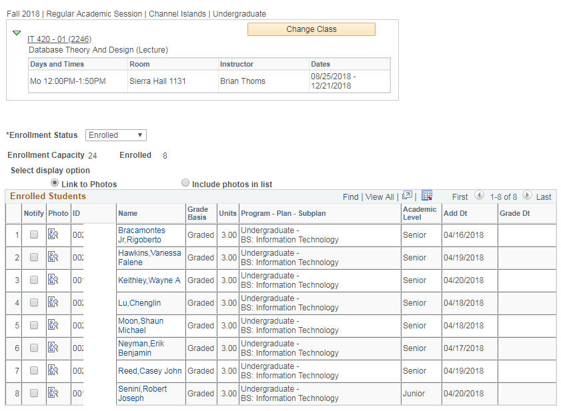
COMP / IT 420 Class Data

Slide 8
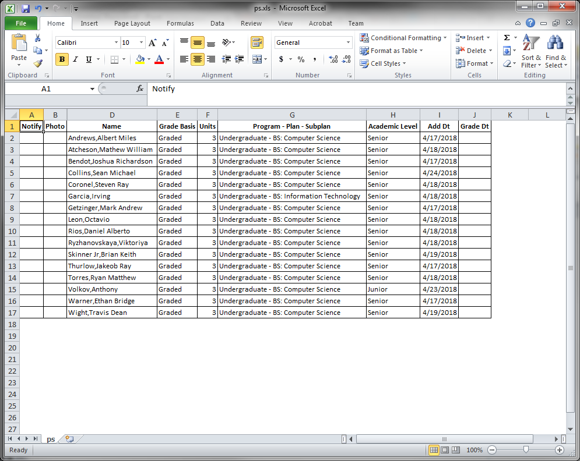
As spreadsheet data
What is the file’s structure?
What happens when I edit this file?
What kinds of controls are placed on this file?

Slide 9
Why Databases?
Databases solve many of the problems encountered in data management, but not all…
Used in almost all modern settings involving data management:
Business, Government, Healthcare, Entertainment, Sports, Academia
Important to understand how databases work and interact with other applications

Slide 10
Data vs. Information
Data
Information
Data = Raw facts
Not yet been processed to reveal the meaning
Building blocks of information
Data management
Generation, storage, and retrieval of data
Result of processing raw data to reveal meaning
Produced by processing data
Reveals the meaning of data
Enables knowledge creation
Should be accurate, relevant, and timely to enable good decision making
Information requires context to reveal meaning
Data are the foundation of information

Slide 11
Examples
Data
Information
Firstname=John
Lastname=Smith
Age=18
Nationality=US Citizen
John Smith can vote in US presidential elections.
John Smith can be tried as an adult.

Slide 12
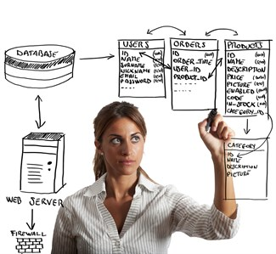
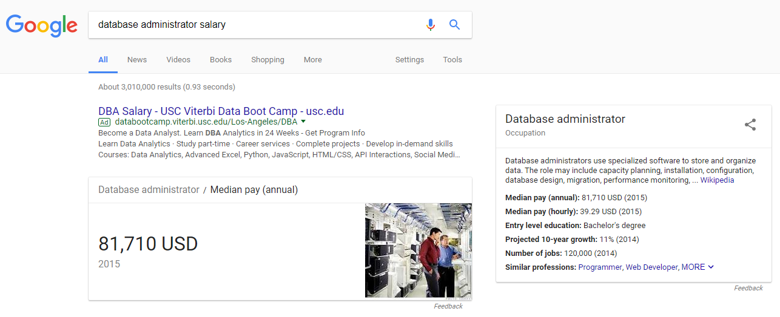
The Role of the DBA
Responsible for organizing organizational data…
Work with business/ systems/ programmer analysts.
This means they create new data formats when needed.

Slide 13

Data at Channel Islands
Is there unique data at CI?
What is this piece of data called?
Why was it needed?
What data communicates across CSU?
What data communicates across the globe?
Ekho

Slide 14
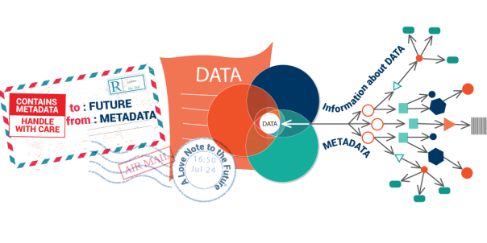
Database
Shared, integrated computer structure that stores a collection of:
End-user data - Raw facts of some importance (or maybe no importance)
Founded in metadata
Data about data
Integrates and manages business data
Describes characteristics and relationships
Places constraints on data entered into the database
Database management system (DBMS)
Collection of programs
Manages the database structure
Controls access to data stored in the database (roles based on least privilege)
Q. In computer software is there such a thing as a physical connection?

Slide 15
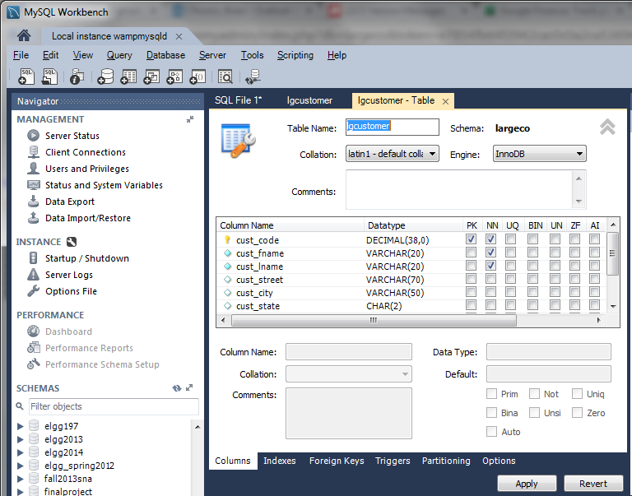
Metadata for a customer table
Identifying metadata:
-
-
-
-

Slide 16
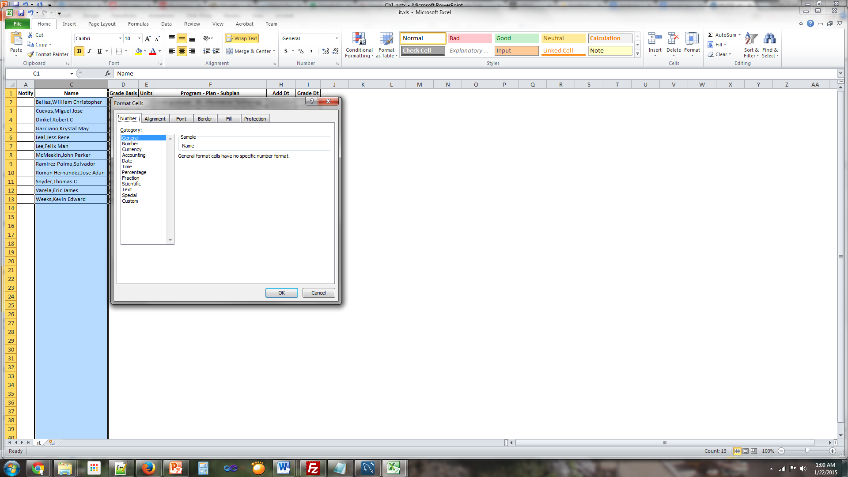
In MS Excel, it would be formatting a column, row or cell and possibly having a header

Slide 17
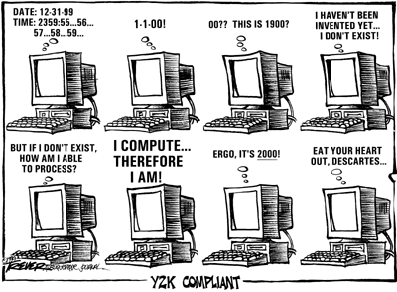
Y2K?

Slide 18
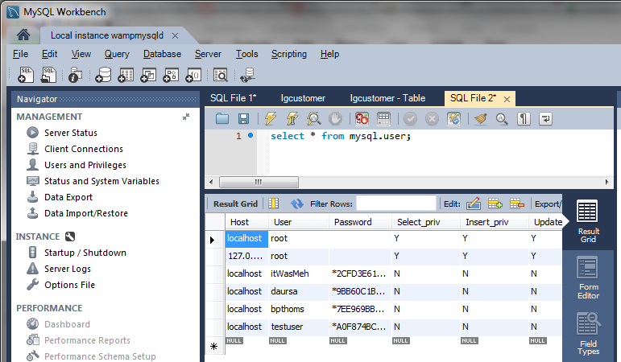
Role of the DBMS
DBMS is database management software
Intermediary between the user and database files
Enables data to be shared
Presents users with an integrated view of the data
Receives and translates application requests into operations required to fulfill the requests
Hides internal complexity from the application programs and users
Open up MySQL Workbench (pray it works) and see for yourself!
By the way, we’re going to need to delete all those databases…

Slide 19
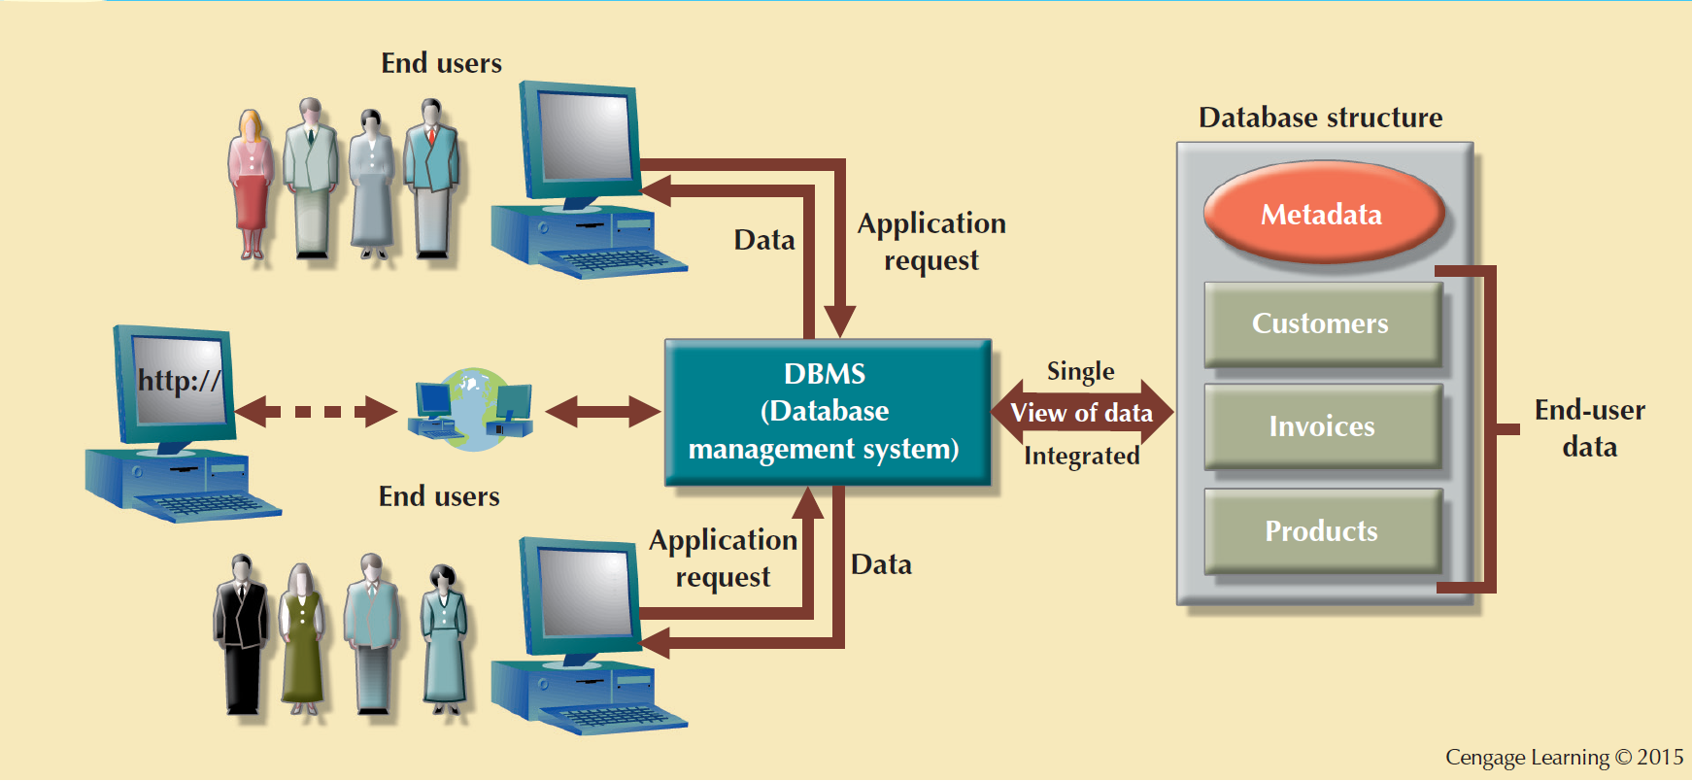
The DBMS Manages the Interaction between the End User and the Database

Slide 20
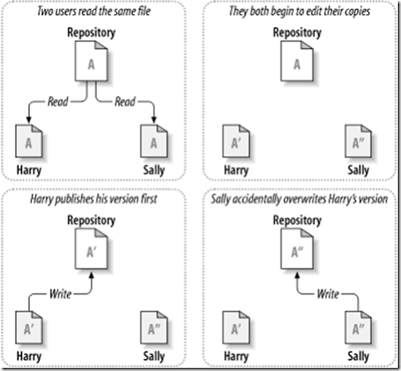
Advantages of the DBMS
Better data integration and less data inconsistency
Data inconsistency: Different versions of the same data appear in different places
Increased end-user productivity
Improve:
Data sharing
Data security
Data access
Decision making
Data quality: Promoting accuracy, validity, and timeliness of data

Slide 21
Disadvantages of the DBMS
Cost
Database packages are pricey
Speed
Queries integrating numerous tables can be slow.
Maintenance
Index rebuilding, database reengineering
RDBMS do not scale well for big data
NOSQL
Vendor Dependence*

Slide 22
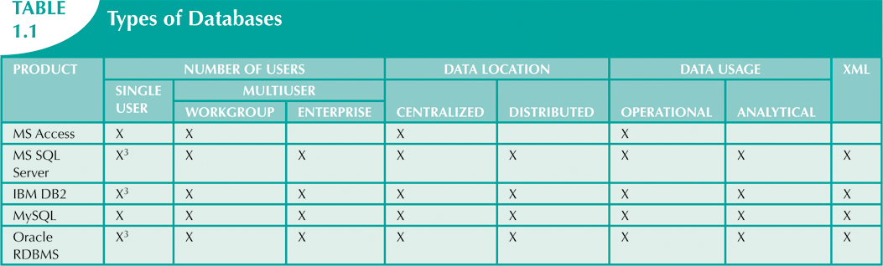

Slide 23
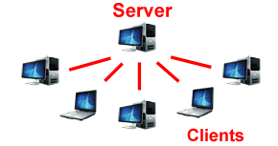
Types of Databases
Single-user database: Supports one user at a time
Desktop database: Runs on PC (i.e. MS Access)
Multiuser database: Supports concurrency
Workgroup databases: Supports a small number of users or a specific department
Enterprise database: Supports many users across many departments

Slide 24
Types of Databases
Centralized database: Data is located at a single site
Distributed database: Data is distributed across different sites and data is synced through replication.
Cloud database: Created and maintained using cloud data services that provide defined performance measures for the database
NoSQL: provides a mechanism for storage and retrieval of data that is modeled in means other than the relational data model.

Slide 25
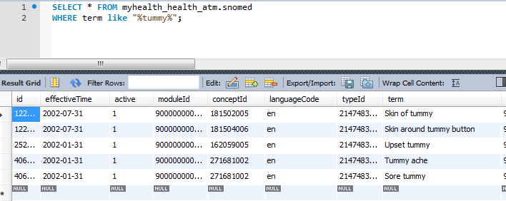
Types of Databases
General-purpose databases: Contains a wide variety of data used in multiple disciplines
Discipline-specific databases: Contains data focused on specific subject areas

Slide 26
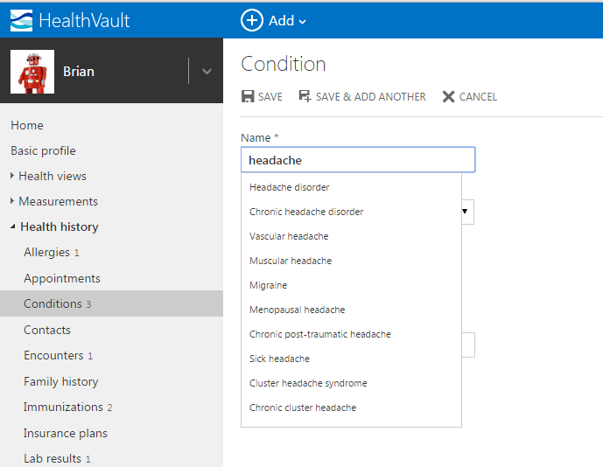
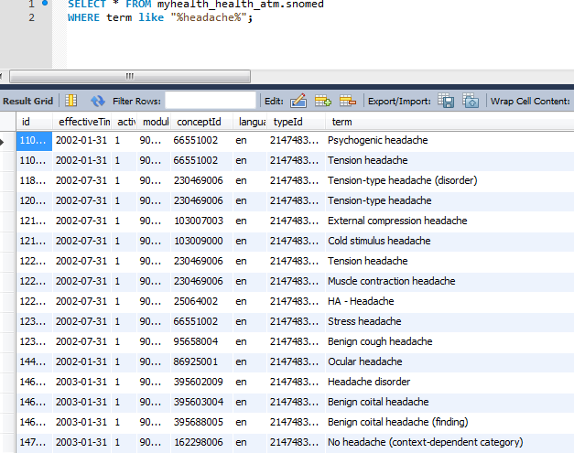
Discipline-specific databases
System
Database

Slide 27
Types of Databases
Operational: Support day-to-day operations
Analytical: Stores historical data and business metrics used for tactical or strategic decision making
Data warehouse: Stores data optimized for decision support
Online analytical processing (OLAP): Enable retrieving, processing, and modeling data from the data warehouse
Business intelligence: Captures and processes business data to generate information that support decision making

Slide 28
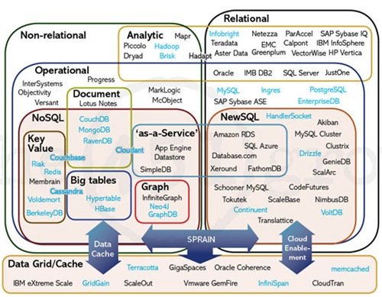
Database Technologies

Slide 29
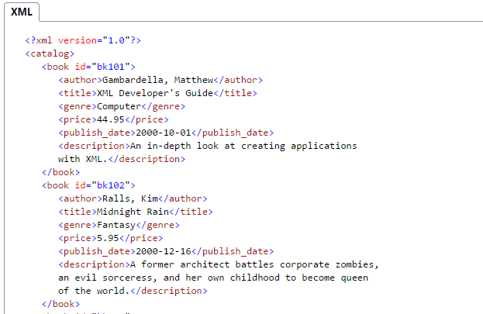
Types of Data
Unstructured data: It exists in their original state (i.e. contents of an email)
Structured data: Structure can applied based on type of processing to be performed (i.e. purchase orders)
Semistructured data: Processed to some extent (i.e. tweets?)
Extensible Markup Language (XML)
Represents data elements in textual format

Slide 30
Database Design
Focuses on the design of the database structure that will be used to store and manage end-user data
Well-designed database
Facilitates data management
Generates accurate and valuable information
Poorly designed database
Lacks data integrity
Can be insecure
Makes error-handling / data validation difficult

Slide 31
Evolution of File System Data Processing
Manual File Systems
Accomplished through a system of file folders and filing cabinets
Computerized File Systems
Data processing (DP) specialist: Created a computer-based system that would track data and produce required reports
File System Redux: Modern End-User Productivity Tools
Includes spreadsheet programs such as Microsoft Excel

Slide 32
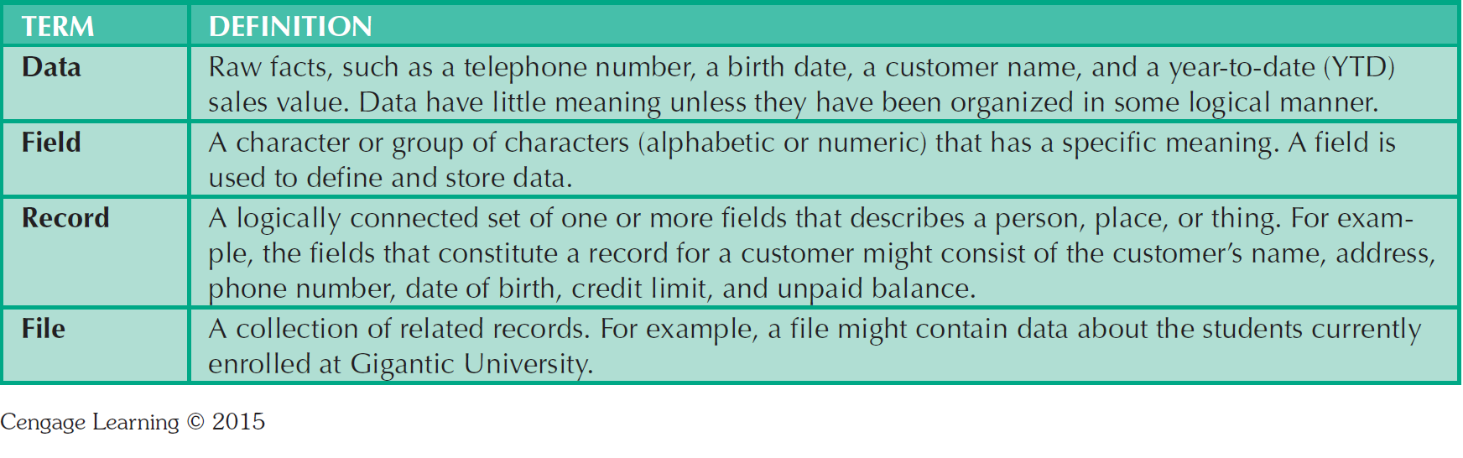
Basic File Terminology

Slide 33
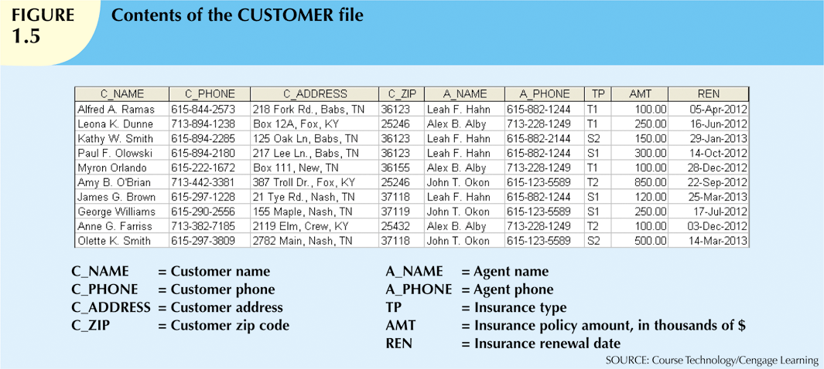
Data? Field? Record? File?

Slide 34
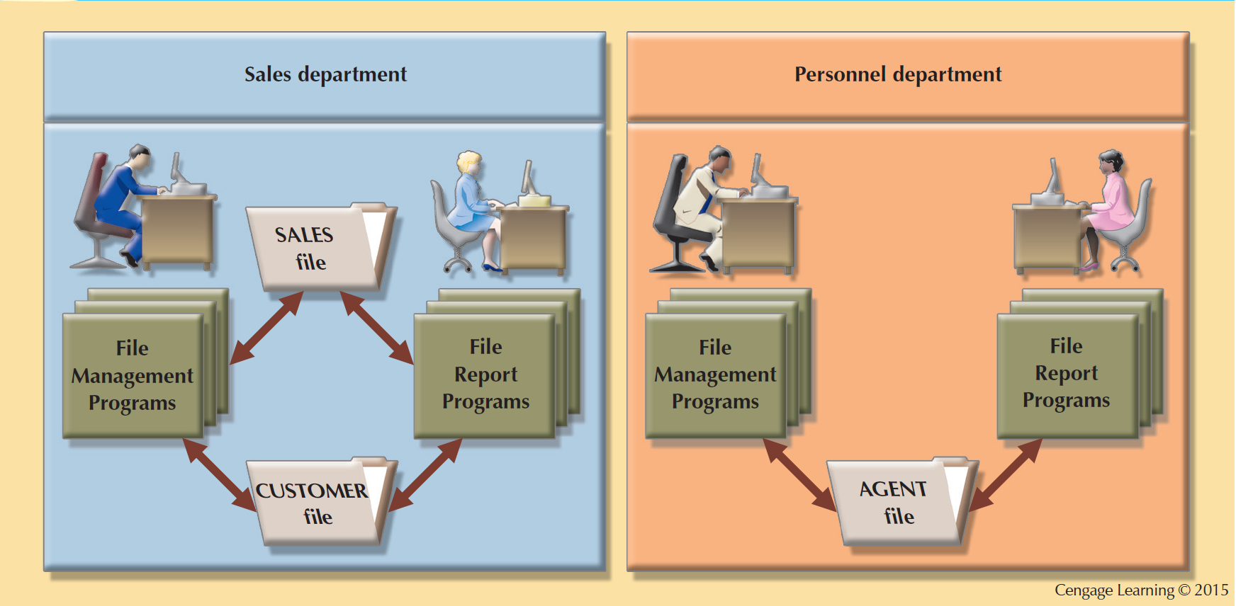
A Simple File System

Slide 35
Problems with File System Data Processing
Lengthy development times
Difficulty of getting quick answers
Complex system administration
Lack of security and limited data sharing
Extensive programming

Slide 36
Structural and Data Dependence
Structural Dependence
Access to a file is dependent on its structure
All file system programs are modified to conform to a new file structure
Structural Independence
File structure is changed without affecting the application’s ability to access the data
Which is better?

Slide 37
Structural and Data Dependence
Data Dependence
Data access changes when data storage characteristics change
Data Independence
Data storage characteristics can be changed without affecting the program’s ability to access the data
Practical significance of data dependence is difference between logical and physical format

Slide 38
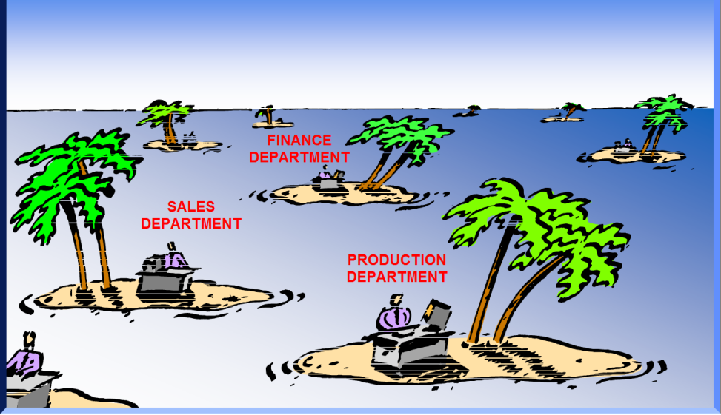

Data Redundancy
Unnecessarily storing same data at different places
Islands of information: Scattered data locations
Increases the probability of having different versions of the same data

Slide 39
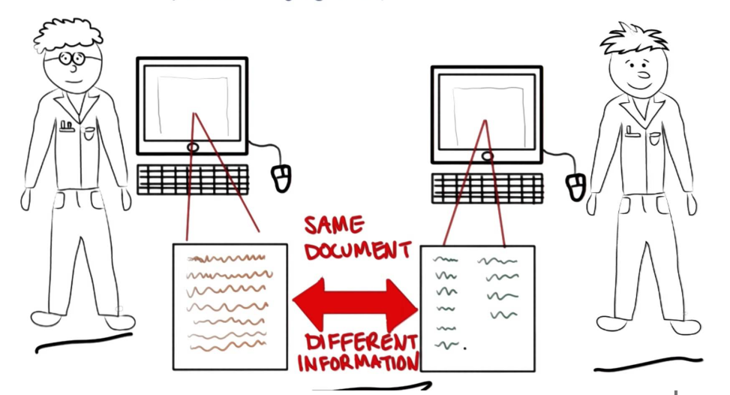
Data Redundancy Implications
Poor data security
Data inconsistency
Increased likelihood of data-entry errors when complex entries are made in different files
Data anomalies occur when not all of the required changes in the redundant data are made successfully.
Deletions
Updates
Insertions

Slide 40
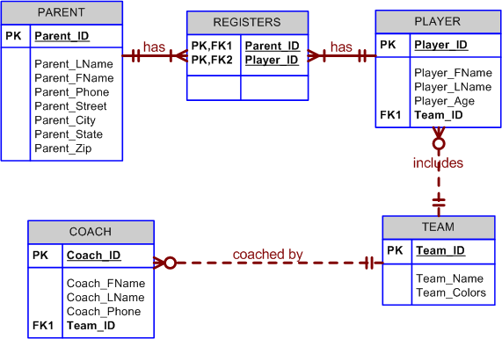
Lack of Design and Data-Modeling Skills
Evident despite the availability of multiple personal productivity tools being available
Data-modeling skills are vital in the data design process
Good data modeling facilitates communication between the designer, end-user, and the developer

Slide 41
Database Systems
Logically related data stored in a single logical data repository
Physically distributed among multiple storage facilities
DBMS eliminates most of file system’s problems
Current generation DBMS software:
Stores data structures, relationships between structures, and access paths
Defines, stores, and manages all access paths and components

Slide 42
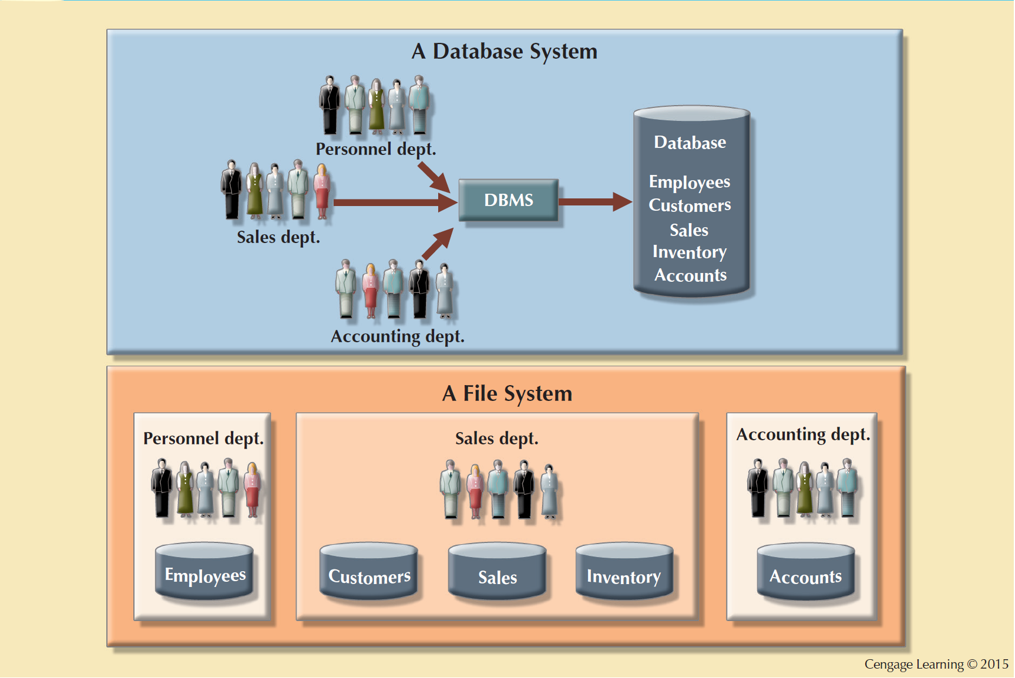
Database vs. File Systems

Slide 43
DBMS Functions (1)
Data dictionary management
Data dictionary: Stores definitions of the data elements and their relationships
Data storage management
Performance tuning: Ensures efficient performance of the database in terms of storage and access speed
Data transformation and presentation
Transforms entered data to conform to required data structures
Security management
Enforces user security and data privacy

Slide 44
DBMS Functions (2)
Multiuser access control
Sophisticated algorithms ensure that multiple users can access the database concurrently without compromising its integrity
Backup and recovery management
Enables recovery of the database after a failure
Data integrity management
Minimizes redundancy and maximizes consistency

Slide 45
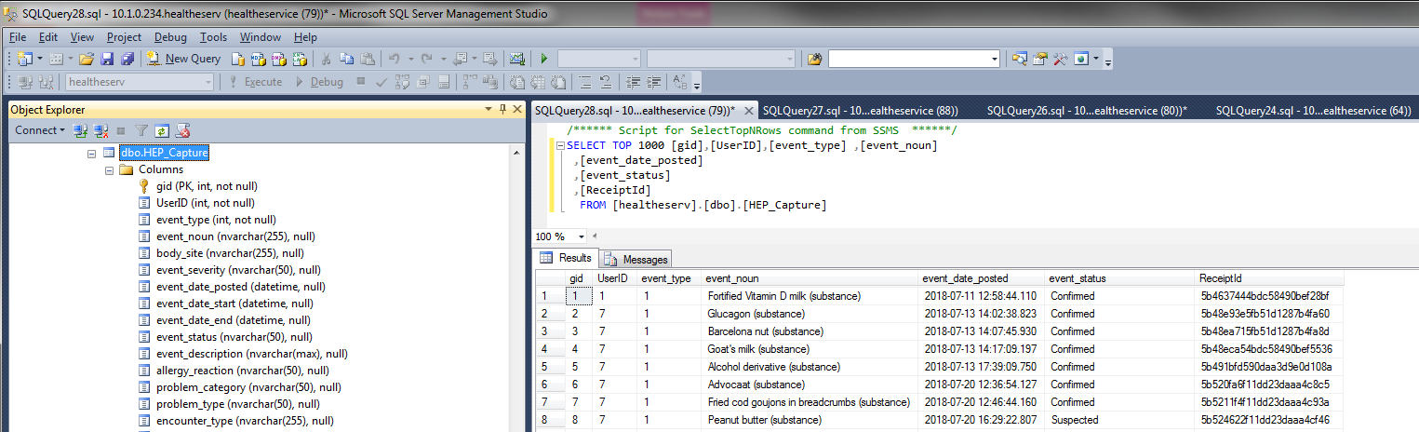
DBMS Example (MS SQL)

Slide 46
DBMS Functions
Database access languages and application programming interfaces
Query language: Lets the user specify what must be done without having to specify how
Structured Query Language (SQL): De facto query language and data access standard supported by the majority of DBMS vendors
Database communication interfaces
Accept end-user requests via multiple, different network environments

Slide 47
Disadvantages of Database Systems
Increased costs
Management complexity
Maintaining currency
Vendor dependence
Frequent upgrade/replacement cycles

Slide 48
Managing the Database System: A Shift in Focus (1)
Database system provides a framework in which strict procedures and standards enforced
Role of human changes from programming to managing organization’s resources
Database system enables more sophisticated use of the data
Data structures created within the database and their relationships determine effectiveness

Slide 49
Managing the Database System: A Shift in Focus (2)
Disadvantages of database systems:
Increased costs
Management complexity
Maintaining currency
Vendor dependence
Frequent upgrade/replacement cycles

Slide 50
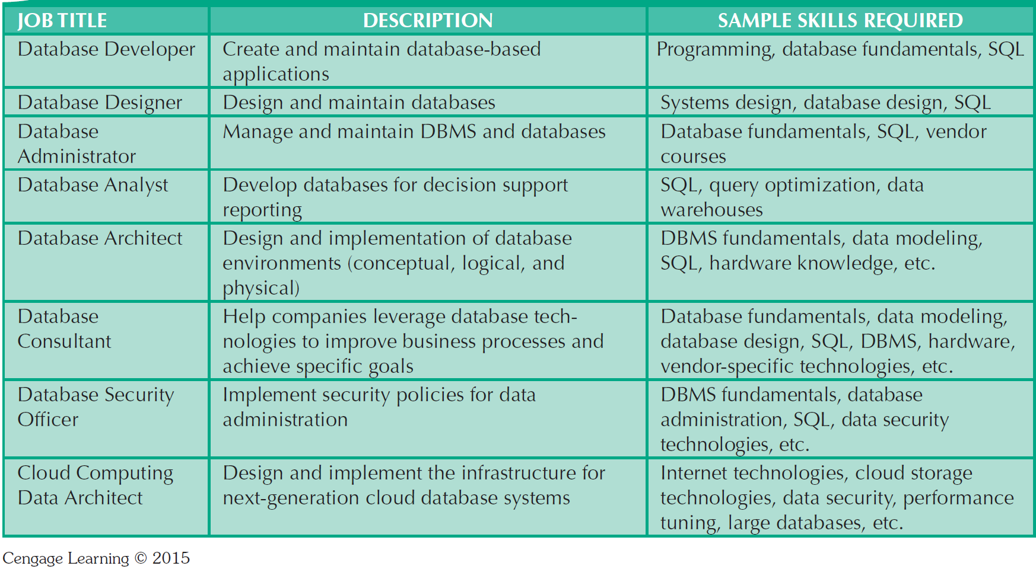
Career Opportunities

Slide 51
DBA Salary

Slide 52
Summary
Data are raw facts
Information is the result of processing data to reveal its meaning
Accurate, relevant, and timely information is the key to good decision making
Data are usually stored in a database
DBMS implements a database and manages its contents

Slide 53
Summary (cont'd.)
Metadata is data about data
Database design defines the database structure
Well-designed database facilitates data management and generates valuable information
Poorly designed database leads to bad decision making and organizational failure
Databases evolved from manual and computerized file systems

Slide 54
Summary (cont'd.)
In a file system, data stored in independent files
Each requires its own management program
Some limitations of file system data management:
Requires extensive programming
System administration is complex and difficult
Changing existing structures is difficult
Security features are likely inadequate
Independent files tend to contain redundant data
Structural and data dependency problems

Slide 55
Summary (cont'd.)
Database management systems were developed to address file system’s inherent weaknesses
DBMS present database to end user as single repository
Promotes data sharing
Eliminates islands of information
DBMS enforces data integrity, eliminates redundancy, and promotes security

